Slide 1
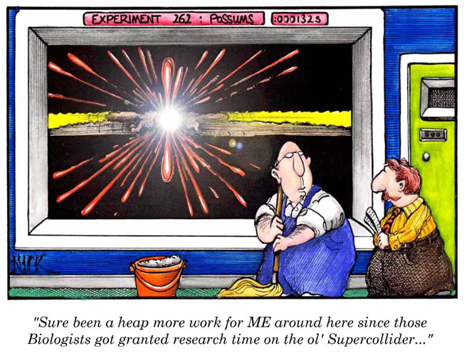
Atomic Structure
www.lab-initio.com

Slide 2
CA Standards
Students know how to relate the position of an element in the periodic table to its atomic number and atomic mass.
Students know the nucleus of the atom is much smaller than the atom yet contains most of its mass.

Slide 3
Modern Atomic Theory
All matter is composed of atoms
Atoms cannot be subdivided, created, or destroyed in ordinary chemical reactions. However, these changes CAN occur in nuclear reactions!
Atoms of an element have a characteristic average mass which is unique to that element.
Atoms of any one element differ in properties from atoms of another element

Slide 4
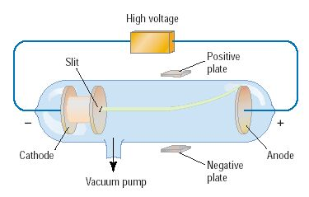
Discovery of the Electron
In 1897, J.J. Thomson used a cathode ray tube to deduce the presence of a negatively charged particle.
Cathode ray tubes pass electricity through a gas that is contained at a very low pressure.

Slide 5
Conclusions from the
Study of the Electron
Cathode rays have identical properties regardless of the element used to produce them. All elements must contain identically charged electrons.
Atoms are neutral, so there must be positive particles in the atom to balance the negative charge of the electrons
Electrons have so little mass that atoms must contain other particles that account for most of the mass

Slide 6
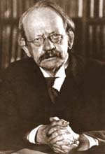
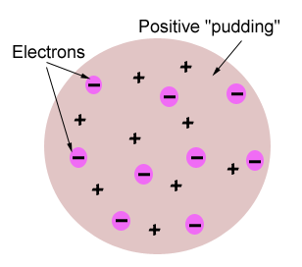
Thomson’s Atomic Model
Thomson believed that the electrons were like plums embedded in a positively charged “pudding,” thus it was called the “plum pudding” model.

Slide 7
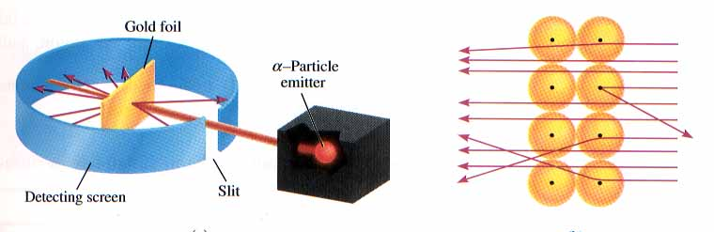
Rutherford’s Gold Foil Experiment
Alpha (α) particles are helium nuclei
Particles were fired at a thin sheet of gold foil
Particle hits on the detecting screen (film) are recorded

Slide 8
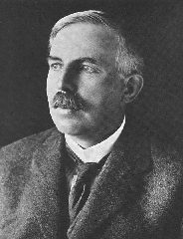
Rutherford’s Findings
Most of the particles passed right through
A few particles were deflected
VERY FEW were greatly deflected
“Like howitzer shells bouncing off of tissue paper!”
Conclusions:
The nucleus is small
The nucleus is dense
The nucleus is positively charged

Slide 9
Atomic Particles
Particle | Charge | Mass # | Location
Electron | -1 | 0 | Electron cloud
Proton | +1 | 1 | Nucleus
Neutron | 0 | 1 | Nucleus

Slide 10
Atomic Number
Atomic number (Z) of an element is the number of protons in the nucleus of each atom of that element.
Element | # of protons | Atomic # (Z)
Carbon | 6 | 6
Phosphorus | 15 | 15
Gold | 79 | 79

Slide 11
Mass Number
Mass number is the number of protons and neutrons in the nucleus of an isotope.
Mass # = p⁺ + n⁰
Nuclide | p⁺ | n⁰ | e⁻ | Mass #
Oxygen - |  | 10
- | 33 | 42
- 31 | 15
18
8
8
18
Arsenic
75
33
75
Phosphorus
16
15
31

Slide 12


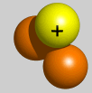
Isotopes
Isotopes are atoms of the same element having different masses due to varying numbers of neutrons.
Isotope | Protons | Electrons | Neutrons | Nucleus
Hydrogen–1 (protium) | 1 | 1 | 0
Hydrogen-2 (deuterium) | 1 | 1 | 1
Hydrogen-3 (tritium) | 1 | 1 | 2

Slide 13
Atomic Masses
Atomic mass is the average of all the naturally occurring isotopes of that element.
Isotope | Symbol | Composition of the nucleus | % in nature
Carbon-12 | ¹²C | 6 protons 6 neutrons | 98.89%
Carbon-13 | ¹³C | 6 protons 7 neutrons | 1.11%
Carbon-14 | ¹⁴C | 6 protons 8 neutrons | <0.01%
Carbon = 12.011

